Slide 1

HOboken Laundry ManagEment System (HOLMES)
By:
Team 1 and Team 2
Neel, Dhruvil, Sarvesh, Abdullah, Nikhil, Drashti, Sonali, Kajal

Slide 2
Background
Today, we live in a world of web
Websites for everything
About 20-25 laundromats in Hoboken without a website
Problems:
Unable to know when is your laundry done/when to pick up
Not having exact change for laundry
Where is the nearest laundromat?

Slide 3
Objectives
The main purpose of this project is to:
Design a website to check the status of laundry
Get notified once your laundry is done
Implement various pages that a website requires (For example: About Us, Contact Us, FAQs, etc).
Learn CSS/HTML/JavaScript
Most importantly, KEEP IT AGILE!

Slide 4
Audience
Users:
Hoboken Residents
Laundromat Owners
Why will they use it?
Convenient way to locate your nearest laundromat and read their offered facilities online
Check their laundry status
To avoid continuous checking, an email notification feature for the user to notify them when their laundry is completed

Slide 5
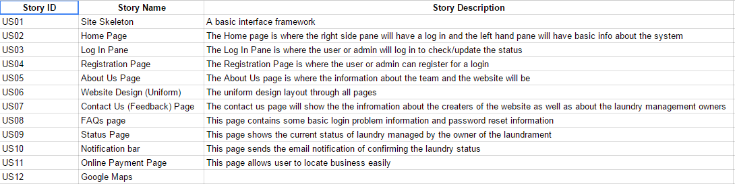
User Stories

Slide 6
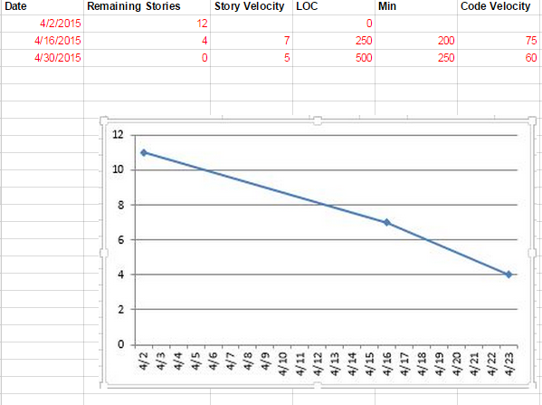
Burndown Chart

Slide 7
Development/Design
Using an open source template.
The website is cross browser compatibility ( Internet Explorer, Mozilla Firefox, Google Chrome etc.).
HTML5, CSS3, JQuery, JavaScript for the front-end.
The Design is Responsive to different screen size (Desktop, Tablet, Smartphone).

Slide 8

LOGO
Before
After

Slide 9
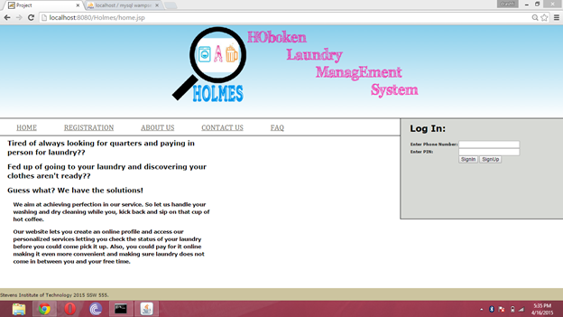
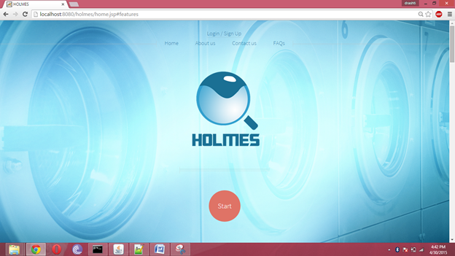
Home Page:
Design Before
Design After

Slide 10
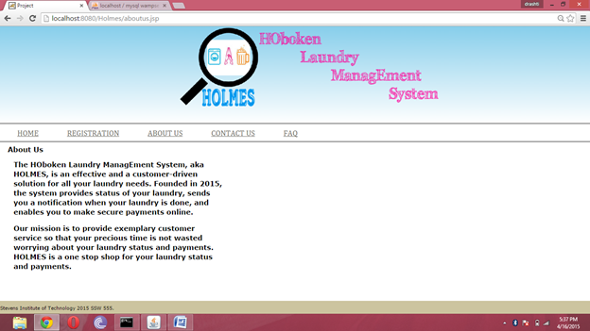
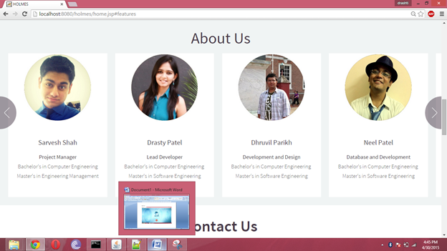
About US Page:
Design Before
Design After

Slide 11
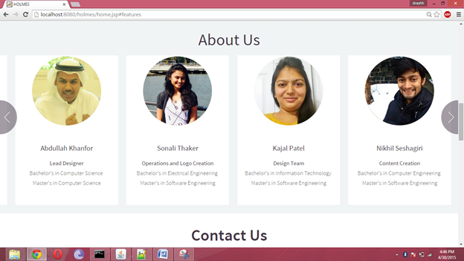
About US Page (Cont..)
Design Before
Design After

Slide 12
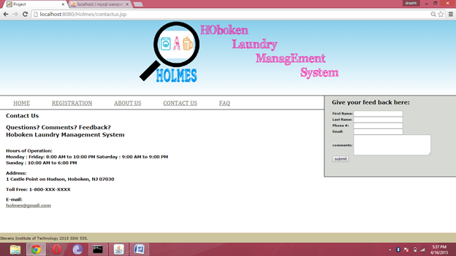
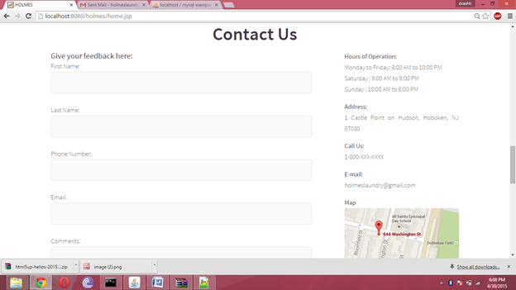
Contact US Page:
Design Before
Design After

Slide 13
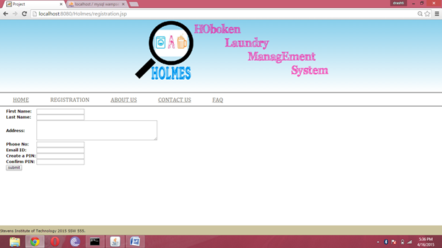
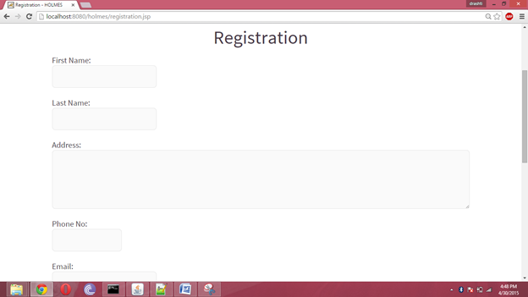
Sign Up Page:
Design Before
Design After

Slide 14
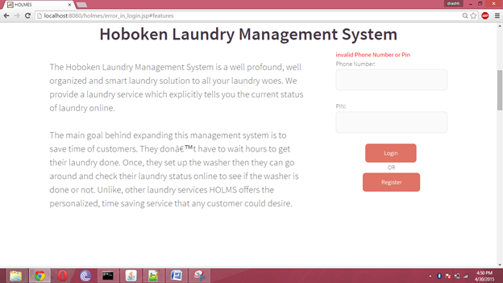
Log In Page:
Design Before
Design After

Slide 15
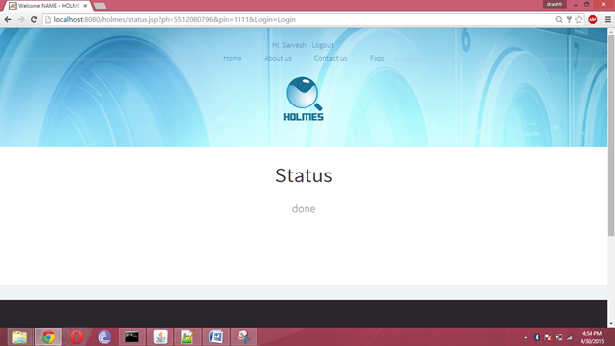
Status Page (For User)

Slide 16
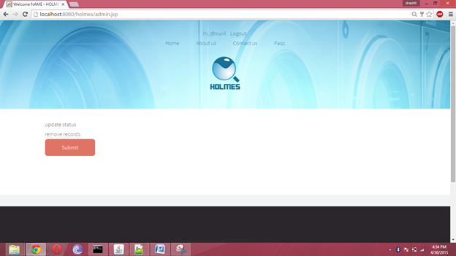
Admin Page

Slide 17
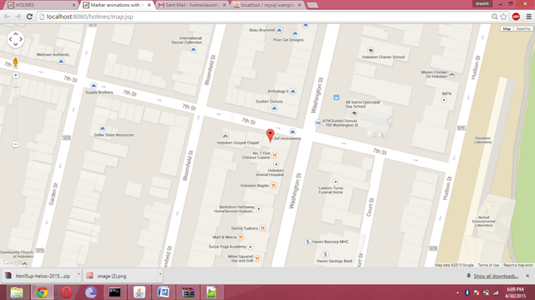
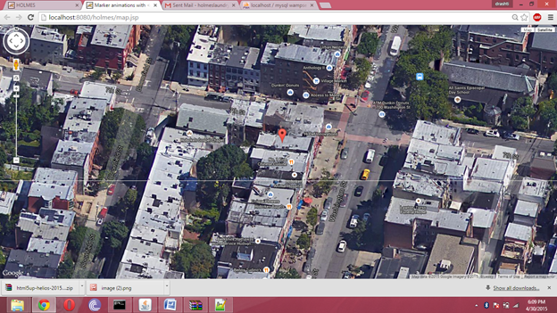
Google Maps

Slide 18
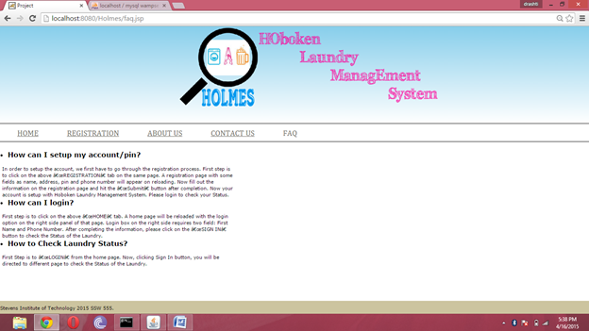
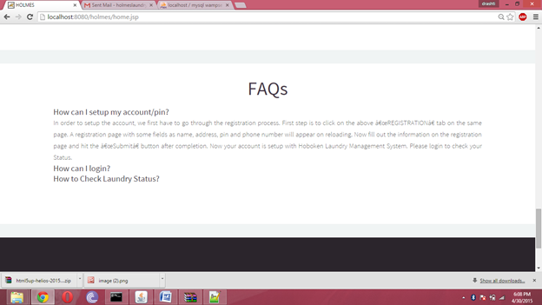
FAQs Page
Design Before
Design After

Slide 19
Key Features
Location finder (Google Maps)
Email notification

Slide 20
SHOWTIME…!
http://localhost:8080/holmes/home.jsp

Slide 21
General Pricing for a Website
There are three different services and package for pricing:
Per Hour: It ranges from $40* to $70*
Per Page: It depends on the experience of the developer and average value is about $80* per page.
Project as whole (Contract based): It depends on the project and customer requirements.
*all prices are excluding IRS taxes and categories.

Slide 22
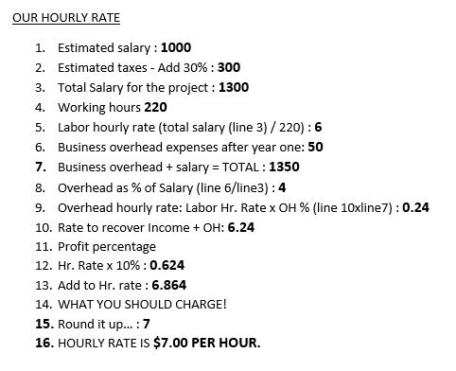
Pricing for Our Website
Time Taken for the project is divided as per the time taken for the team as a whole
The overheads mentioned are for the fees to maintain the site.
Pointers taken for consideration while estimation of working hours:
Learning Period
Mistake Correction
Salary Estimation
Charge for Graphics Design
Email Notification Charge

Slide 23
Future Implementation
Payment Options
Get Permission from Cell Phone service Provider to send text notifications to the customer
Go LIVE!

Slide 24
Agile Techniques/Learnings
User Stories
Scrum Meetings
Pair Programming
Development and Testing side by side
SAF (Scaled Agile Framework)
“Hardening” Iteration
FDD (Feature Driven Development)
Google Maps
We had a lot of fun working together!

Slide 25

Questions

